Slide 1
Time-series and Elman Network
CSE301 Bio-computation, Week 9, 2016
Bailing Zhang

Slide 2
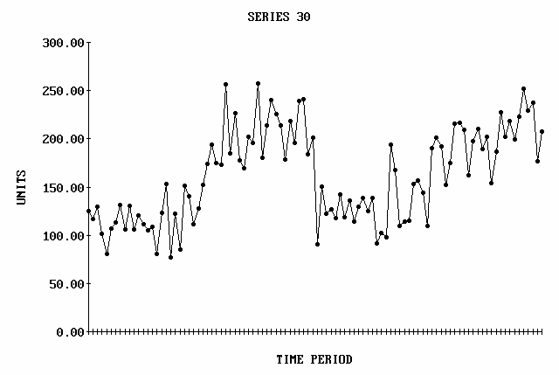
Time Series
What is a time series?
– Time Series is a series of timely ordered, comparable observations y_{t} recorded in equidistant time intervals
Examples:
– Stock prices
– Temperature readings
Y_{t} represents the t^{th} period
observation, t=1,2 … n

Slide 3
Time Series
Modeling of a time series
Values of a time series at successive time indices are often
correlated. Otherwise, prediction is impossible.
Most time series can be modeled mathematically as a wide-sense stationary (WSS) random process. The statistical properties do not change with respect to time.
Some time series exhibits chaotic nature. A chaotic time series can be described by a deterministic model but behaves as if it is random, and highly un-predictable.

Slide 4
Time Series Models
In statistics and machine learning, a time-series is often described by a sequence of vectors (or scalars) which depend on time t (we will deal exclusively with scalars):
It’s the output of some process P that we are
interested in:
P
Observed time-series
Unknown dynamics (process)

Slide 5
Continuous Phenomena
t is real-valued, and x(t) is a continuous signal.
To get a series {x[t]}, must sample the signal at discrete points.
In uniform sampling, if our sampling period is t, then

Slide 6
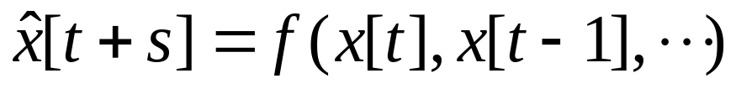

Problem of Predicting the Future
Extending backward from time t, we have time series {x[t], x[t −1], · · ·}. From this, we now want to estimate x at some future time
s is called the horizon of prediction. At beginning, let's predict just one time sample into the future, ⇒ s = 1.
This is a function approximation problem.
Here’s how we’ll solve it:
1. Assume a generative model.
2. For every point x[t_{i}] in the past, train the generative model
with what preceded t_{i} as the inputs and what followed t_{i} as the desired.
3. Now run the model to predict from {x[t], · · ·}.

Slide 7
Time Series Prediction
Time series Examples
  Financial (e.g., stocks, exchange rates)
  Physically observed (e.g., weather, sunspots, river flow)
Why is it important?
  Preventing undesirable events by forecasting the event, identifying the circumstances preceding the event, and taking corrective action so the event can be avoided;
  Forecasting undesirable, yet unavoidable, events to preemptively lessen their impact (e.g., solar maximum w/ sunspots)
  Profiting from forecasting (e.g., financial markets)

Slide 8
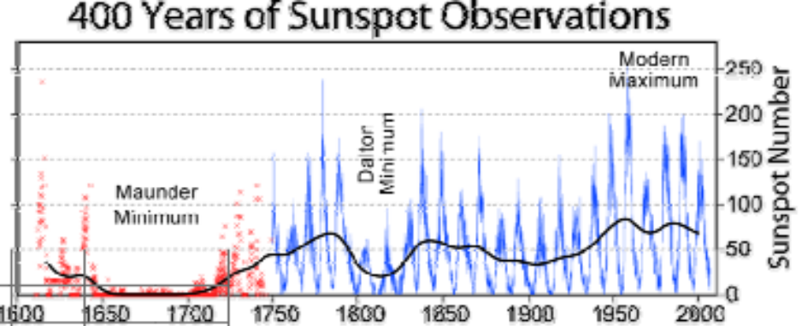
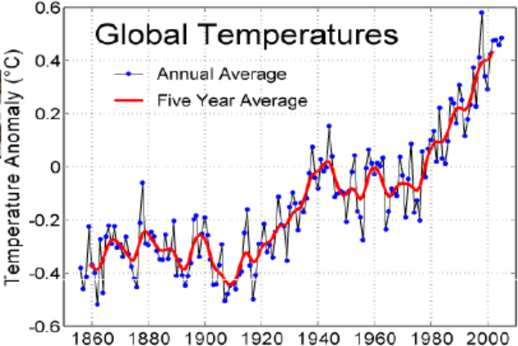
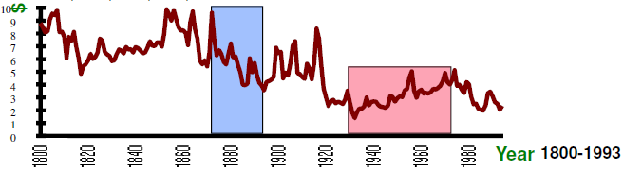
More Examples of Time Series
Sunspot activity
Global Warming
Real Copper Prices in $ per KG

Slide 9
Time Series Prediction
Why is it difficult?
  Limited quantity of data (Observed data series sometimes too short to partition)
  Noise (Erroneous data points, obscuring component)
  Non-stationarity (Fundamentals change over time, nonstationary)
  Forecasting method selection (Statistics, Artificial intelligence)
Neural networks have been widely used as time series forecasters: most often these are feed-forward networks which employ a sliding window over the input sequence.
The neural network sees the time series X₁,…,X_{n} in the form of many mappings of an input vector to an output value.

Slide 10
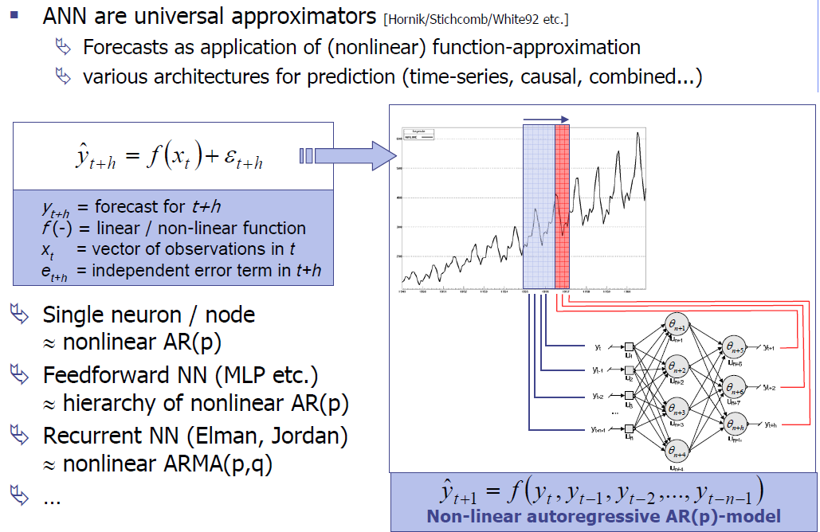

Time Series Prediction with ANN

Slide 11
Time Series Prediction with Artificial Neural Networks
A number of adjoining data points of the time series (the input window X_{t-s}, X_{t-s-1},…, X_{t}) are mapped to the interval [0,1] and used as activations for the input of the input layer.
The size s of the input window corresponds to the number of input units of the neural network.
In the forward path, the activations are propagated over one hidden layer to one output unit. The error used for the BP training is computed by comparing the value of the output unit with the value of the time series at time t+1.
Training a MLP network with BP learning algorithm usually requires that all representations of the input set (called one epoch) are presented many times.

Slide 12
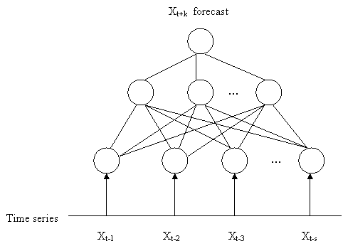

Slide 13
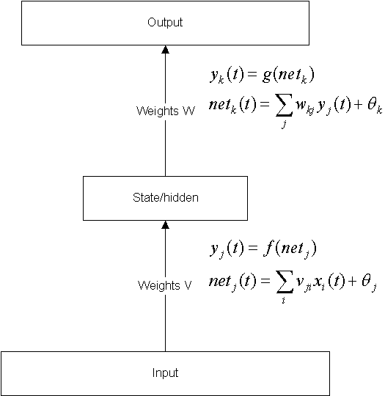
Feed forward neural network revisit
_{Output}
A feed forward NN with
hidden nodes, trained by
e.g. BP, develops internal
representations for the input
signals that recode those
signals in a manner that
enables the network to
produce the correct output.
_{State/hidden}
_{Input}

Slide 14
Time-series and Elman Network
CSE301 Bio-computation, Week 9, 2016
Bailing Zhang

Slide 15
Motivation for dynamic networks
Sometimes, we require our model to be sensitive to inputs that were presented some time ago.
In other words, our requirement is not met by a function (no matter how complex it may be) and demands a model which maintains a state, or memory, over several presentations.
Which applications need memory?
  sequential input (e.g. language understanding, robot exploration, ...),
  sequential output (e.g. speech, route planning, ...), or combinations of the above.

Slide 16

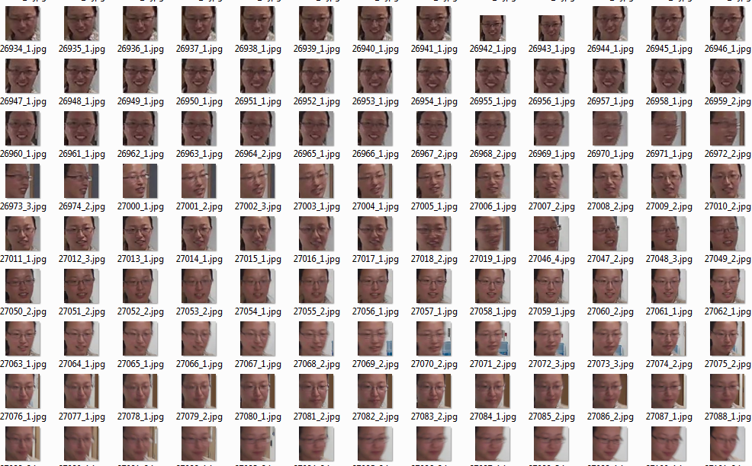
Sequence Examples

Slide 17
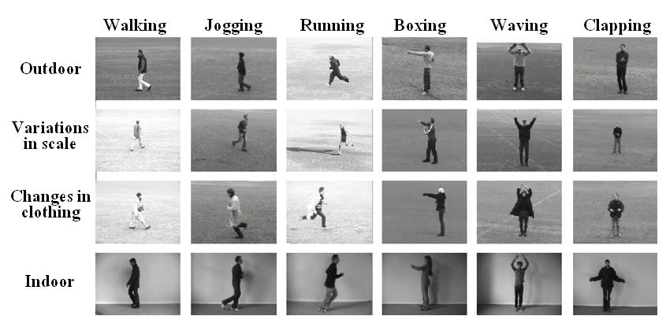
Sequence Examples

Slide 18
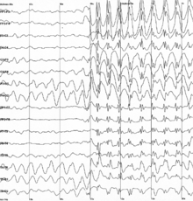
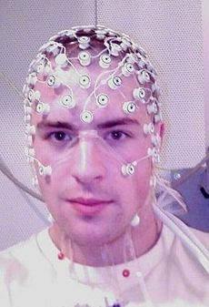
Electroencephalography
(EEG脑电图 )

Slide 19
Sequence Learning
MLP & RBF networks are static networks, i.e., they learn a mapping from a single input signal to a single output response for an arbitrary large number of pairs;
Dynamic networks learn a mapping from a single input signal to a sequence of response signals, for an arbitrary number of pairs (signal, sequence).
Typically the input signal to a dynamic network is an element of the sequence and then the network produces as a response the rest of the sequence.
To learn sequences we need to include some form of memory (short term memory) to the network.

Slide 20
Sequence Learning II
We can introduce memory effects with two principal ways:
  Implicit: e.g., Time lagged signal as input to a static network or as recurrent connections
  Explicit: e.g., Temporal Backpropagation Method
In the implicit form, we assume that the environment from which we collect examples of (input signal, output sequence) is stationary. For the explicit form the environment could be non-stationary, i.e. the network can track the changes in the structure of the signal.

Slide 21
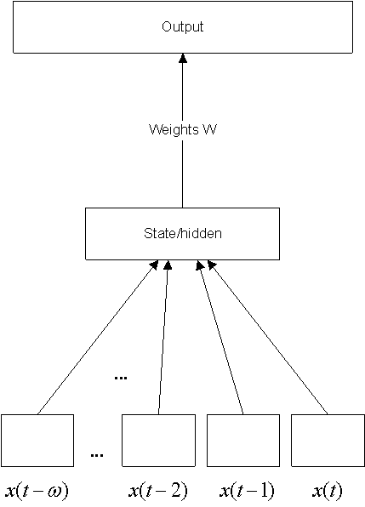
A tapped delay line network
_{output}
Signals can be buffered externally and presented at additional input nodes (input banks).
Time is made explicit, by adding new input dimensions.
This is called
Time Delayed Network
_{State/hidden}

Slide 22
Time Delayed Networks
Time Delayed Networks illustrate the implicit representation approach for sequence learning, which combine a static network (e.g. MLP / RBF) with a memory structure (e.g. tapped delay line).
A good example is the NETtalk network:
In 1987 Sejnowski & Rosenberg built a large three-layer perceptron that learned to pronounce English words.
The net was presented with seven consecutive characters (e.g., “_a_cat_”) simultaneously as input.
NETtalk learned to pronounce the phoneme associated with the central letter (“c” in this example)

Slide 23
The NETtalk Network
teacher
/k/
target output
26 output units
80 hidden units
7 groups of 29 input units
_
a
_
c
a
t
_
7 letters of text input
target letter
present the data in a sliding window

Slide 24
Dynamical Neural Nets
Introducing time
Recurrent nets can explicitly deal with inputs that are presented sequentially, as they would almost always be in real problems.
Recurrent networks are fundamentally different from feed forward networks in that they not only operate upon an input but also a state.
The ability of the net to reverberate and sustain activity can serve as a working memory.
Such nets are called Dynamical Neural Nets (DNN or DRNN).

Slide 25
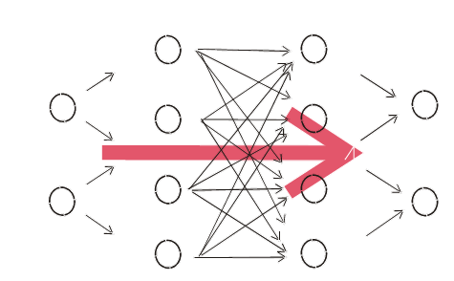
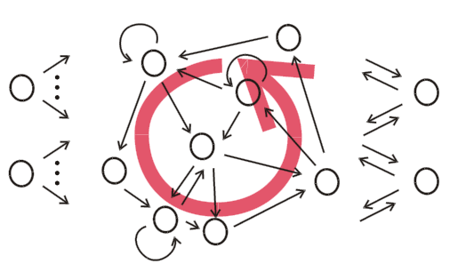
From feed-forward to recurrent NN
Recurrent neural network (RNN) has (at least one) cyclic path of synaptic connections.
Mathematically, RNNs implement dynamical systems.

Slide 26
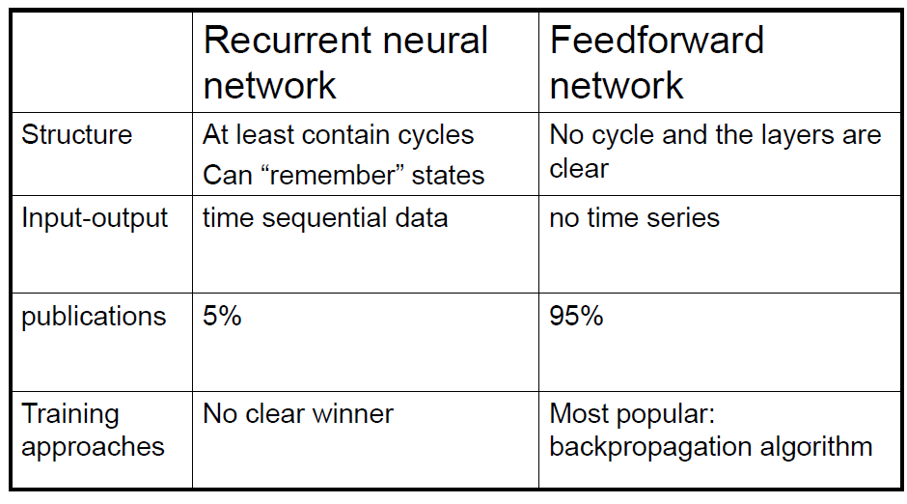
Characterization comparison

Slide 27
Category
Discrete-time recurrent neural network (DTRNN)
  –The processing occurs in discrete steps, as if the network was driven by an external clock
Continuous-time recurrent neural network (CTRNN)
  –The processing occurs in continuous time

Slide 28
Supervised learning for RNNs
Backprop through Time:
  Calculate errors at output nodes at time t
  Backpropagate the error to all nodes at time t-1
  repeat for some fixed number of time steps (usually<10)
  Apply usual weight fixing formula
Real Time Recurrent Learning:
  Calculate errors at output nodes
  Numerically seek steepest descent solution to minimise the error at each time step.
Both methods deteriorate with history: The longer the history, the harder the training. However, with slight variations, these learning algorithms have successfully been used for a variety of applications.
Examples: grammar learning &
distinguishing between spoken languages.

Slide 29


Elman Network
Elman neural network was proposed by Jeffrey L. Elman, 1990.
It is a simple recurrent neural network
Elman network has a powerful prediction capability

Slide 30
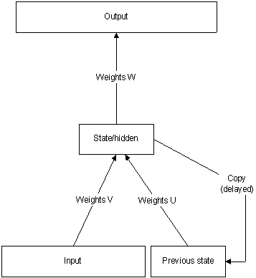
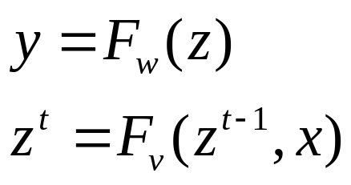
Elman Network
Elman network which typically distinguishes between a state-output function and an input-state mapping. If we describe them as functions they look like this:
where y is the output, x is the
input and z is the state. t is an
index in time.
time is represented implicitly, by the effect it has on processing (rather than adding input dimensions).

Slide 31
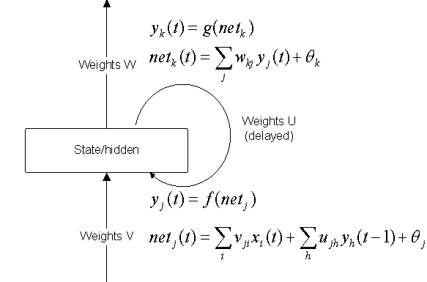
In Elman net, the internal representations are now
engaged in the next step as an additional input.
Output
Note that all equations
are the same as for the
feed forward case. The
only difference is that
we have another set of
weights (U) which feed
activations from the
hidden nodes to the
hidden nodes. Importantly,
the feedback is delayed.
Weights U
(delayed)
_{State/hidden}
Input

Slide 32
Properties of simple recurrent networks (Elman net)
trainable from examples with backpropagation (but slower than with feed forward networks),
outputs can account for past inputs by utilizing activation trace,
typically require less weights compared with a tapped delay line,
abstract events (inputs or combinations of inputs) in time, and employ discrete-time dynamics

Slide 33
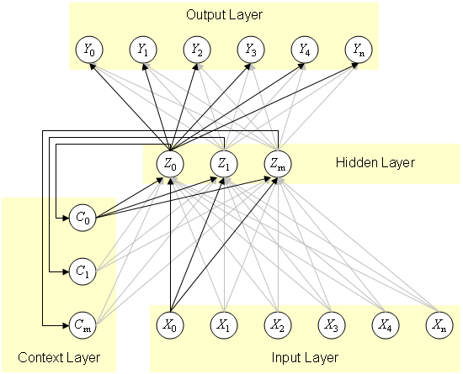
Structure of Elman Network
Four layers of Elman network
Input layer
Hidden layer forming internal representation
Context layer
The value of the context neuron is used as an extra input signal for all the neurons in the hidden layer one time step later. In an Elman network, the weights from the hidden layer to the context layer are set to one and are fixed because the values of the context neurons have to be copied exactly
Output layer linear combination

Slide 34
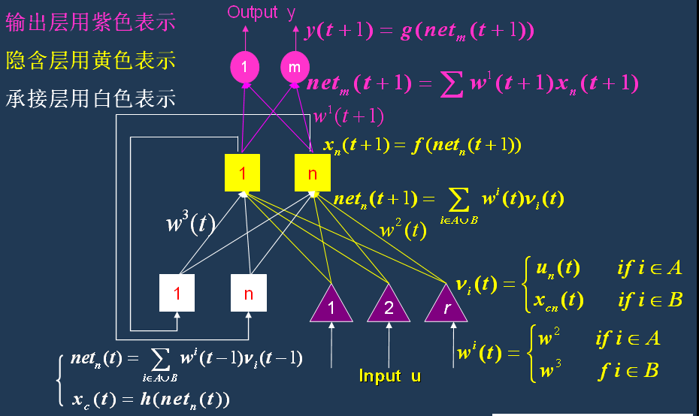
Output layer: purple
Hidden layer: yellow
Context layer: white

Slide 35
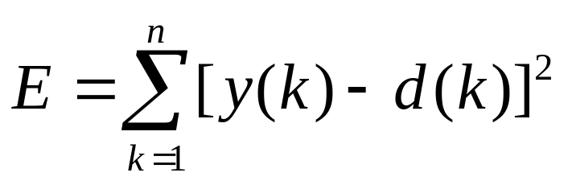

Learning algorithm for Elman Network
Elman network adopts BP algorithm
  The error function：
  where is the expected output (target)
The flowchart of Elman network training

Slide 36
Matlab Implementation of Elman Network
Important functions of Elman network
Functions | definition
newelm() | Create an Elman backpropagation network (old)
elmannet | Create an Elman backpropagation network (new)
trains() | Sequential order incremental training w/learning functions
traingdx() | Gradient descent with momentum and adaptive learning rate backpropagation
learngdm() | Gradient descent with momentum weight and bias learning function

Slide 37
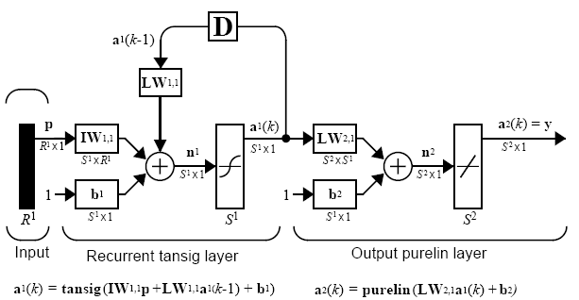
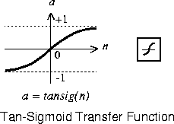
MATLAB NN Toolbox: Elman Networks
The Elman network has tansig neurons in its hidden (recurrent) layer, and purelin neurons in its output layer.
This combination is special in that two-layer networks with these transfer functions can approximate any function (with a finite number of discontinuities) with arbitrary accuracy.

Slide 38
Creating an Elman Network
(old implementation)
An Elman network can be created with function newelm() .
Syntax:
net=newelm(PR,[S1 S2...SNl],{TF1 TF2...TFNl},BTF,BLF,PF)
PR - Rx2 matrix of min and max values for R input elements.
Si - Size of ith layer, for Nl layers.
TFi - Transfer function of ith layer, default = 'tansig'.
BTF - Backprop network training function, default = 'traingdx'.
BLF - Backprop weight/bias learning function, default = 'learngdm'.
PF - Performance function, default = 'mse'.
Example
net = newelm([0 1],[5 1],{'tansig','logsig'});
The training function BTF can be any of the backpropagation training functions
such as TRAINGD, TRAINGDM, TRAINGDA, TRAINGDX, etc.

Slide 39
Simulating an Elman Network in NN Toolbox
E.g.,finding the response of this network to an input sequence of eight digits that are either 0 or 1.
convert P to cell array form
P = round(rand(1,8))
Pseq = con2seq(P);
Y = sim(net,Pseq)
z = seq2con(Y);
convert Y back to concurrent form

Slide 40
Training an Elman Network in NN Toolbox
Elman networks can be trained with either of train or adapt.
  Regarding the difference refer to Matlab document
Elman networks are not as reliable as some other kinds of networks because both training and adaption happen using an approximation of the error gradient.
For an Elman to have the best chance at learning a problem it needs more hidden neurons in its hidden layer than are actually required for a solution by another method.
Ref: Neural Network Toolbox 6 User’s Guide,
Chapter 13 Historical Networks

Slide 41
Example
P = round(rand(1,8))
%P = 1 0 1 1 1 0 1 1
T = [0 (P(1:end-1)+P(2:end)==2)]
%T = 0 0 0 1 1 0 0 1
net = newelm([0 1],[5 1],{'tansig','logsig'});
net = train(net,Pseq,Tseq);
Y = sim(net,Pseq);
z = seq2con(Y); z{1,1};
diff1 = T - z{1,1}
Note that the difference between the target and the simulated output of the
trained network is very small. Thus, the network is trained to produce the
desired output sequence on presentation of the input vector P.

Slide 42
New Implementation in Matlab (R2012b)
elmannet
elmannet(layerdelays, hiddenSizes, trainFcn) these arguments
layerdelays
Row vector of increasing 0 or positive delays (default = 1:2)
hiddenSizes
Row vector of one or more hidden layer sizes (default = 10)
trainFcn
Training function (default = 'trainlm')
Example
[X,T] = simpleseries_dataset;
net = elmannet(1:2,10);
[Xs,Xi,Ai,Ts] = preparets(net,X,T);
net = train(net,Xs,Ts,Xi,Ai);
view(net); Y = net(Xs,Xi,Ai);
perf = perform(net,Ts,Y)

Slide 43
A real-world example:
Prediction of load of air-conditionor
The record of load of air-conditionor btw 9am to 12:00 within one week in a company (next slide).
The data has already normalized.
Predict the 7th data load using the previous six days’ recorded data as the training samples.

Slide 44
Load of air-conditionor
time | Load at 9 | Load at 10 | Load at 11 | Load at 12
Day 1 | 0.4413 | 0.4707 | 0.6953 | 0.8133
Day 2 | 0.4379 | 0.4677 | 0.6981 | 0.8002
Day 3 | 0.4517 | 0.4725 | 0.7006 | 0.8201
Day 4 | 0.4557 | 0.4790 | 0.7019 | 0.8211
Day 5 | 0.4601 | 0.4811 | 0.7101 | 0.8298
Day 6 | 0.4612 | 0.4845 | 0.7188 | 0.8312
Day 7 | 0.4615 | 0.4891 | 0.7201 | 0.8330

Slide 45
Prepare input/target for the training data
P=[0.4413 0.4707 0.6953 0.8133 0.4379 0.4677 0.6981 0.8002 0.4517 0.4725 0.7006 0.8201;
0.4379 0.4677 0.6981 0.8002 0.4517 0.4725 0.7006 0.8201 0.4557 0.4790 0.7019 0.8211;
0.4517 0.4725 0.7006 0.8201 0.4557 0.4790 0.7019 0.8211 0.4601 0.4811 0.7101 0.8298]';
T=[ 0.4557 0.4790 0.7019 0.8211;
0.4601 0.4811 0.7101 0.8298;
0.4612 0.4845 0.7188 0.8312]';
% we use threshold to present the range of inputs [0 1]
threshold=[0 1;0 1;0 1;0 1;0 1;0 1;0 1;0 1;0 1;0 1;0 1;0 1];
%Creat a Elman nerual network,
%The number of hidden layer neurons is 17 and
%The number of output neurons is 4
%activation function is tansig in hidden layer
%activation function is purelin in output
net=newelm(threshold,[17,4],{'tansig','purelin'});
net.trainParam.epochs=3000;
net=init(net);
net=train(net,P,T);

Slide 46
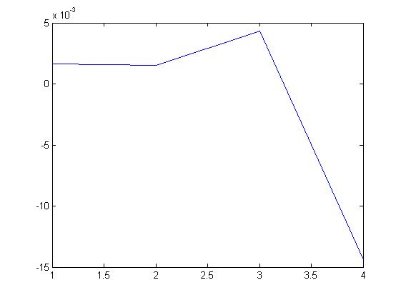
%input testing data
Ptest=[0.4557 0.4790 0.7019 0.8211 0.4601 0.4811 0.7101 0.8298 0.4612 0.4845 0.7188 0.8312]';
Ttest=[0.4615 0.4891 0.7201 0.8330]';
y=sim(net, Ptest);
%calculate the error between output and target
error=y- Ttest;
%plot curve of error
plot(1:4,error,'-');

Slide 47
END

